Slide 1
Towards The Systematic Design of Model Animation
Key Ingredients and General Guidelines
Moussa Amrani, Abdelkader Ouared,
Pierre-Yves Schobbens
Modeling Language Engineering (Mle) Workshop
Co-Located with MoDELS 2022
Sunday 23rd October, Montréal, Canada
Notes:
Hello, everyone. Thanks for coming., my name is ouared abdelkader I’m a post doc researcher from Namur University of Belgium
it my pleasure to be here with you
In this presentation, i will share with you a part of my research intitiled:
Towards The Systematic Design of Model Animation:
Key Ingredients and General Guidelines

Slide 2

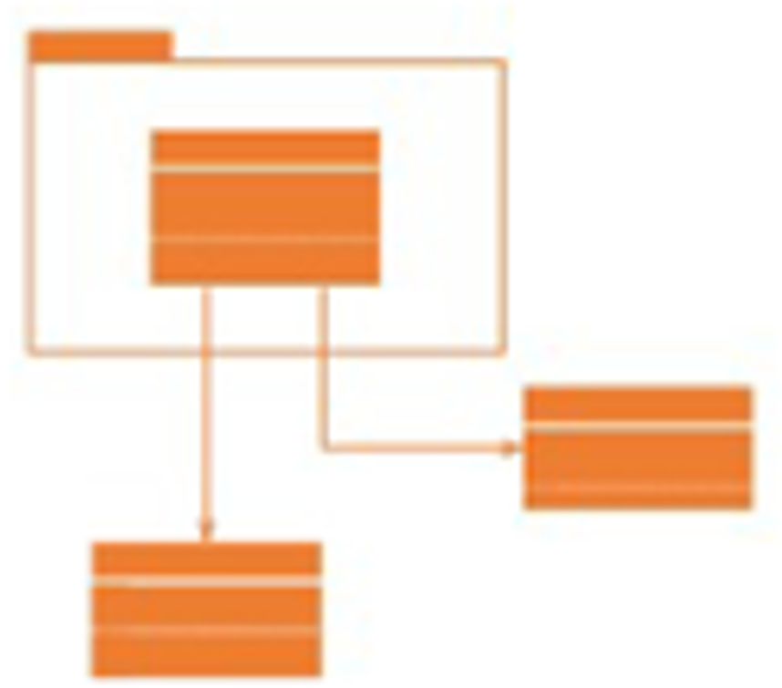



Designing DSL
Metamodel
Transformation Language
Conforms to
Language
Designer
Transformation Expert
Transformation Specification
Conforms to
Model
Analysis
Editor: Model Definition
Palette
trans_{exe}
Modeller
Class
Code Gen.
●●●
Relationship
< game : Game |
score = 0; level = [ unique : Level];
personas = [ pacman, ghost] >
….
…
Notes:
As we konw, to design a domain specifi language:
We have ,,
As we know in the MDE, we have, at the metamodel level the language designer, who is responsible to design a metamodel for a specific domain
Transformation expert define the behavioral semantic of the language
At the level of model the modeller designe models conforms to the MM using dedicated editor
These models be transformed for different purpose like debugging , code generation and ana-lyisis
As we know in the MDE, we have, at the metamodel level the language designer, who is responsible for design a DSL
At the model level, we have the modeller , his task is to define a model conforms to a metamodel
Tranformation expert actor, his role is to define the language semantic and generate the application of end users
In this study, we introduce a MA designer as new role, to define the animation according to the MT execution,
In MDE we have Actors at different level, at the level of metamodel, we have language designer who is responsible to design a DSML
At the Model level, we found modeller, his task is to define a model that must be conform to MM
The third actor is transformation expert, his role is to define the language semantic and generate the application of end users
Here, we need to introduce a MA as new role, to define the animation corresponding to the MT execution,
-------
DSL designer (engineer) define the metamodel and the transformation for the execution metamodel
Transformation designer : define the transformation pour autre choses comme le test , la verification, la validation, etc.
Animation: relier l’execution de l’animation avec la transformation
Toutes les variables sont discretes, le temps est descret

Slide 3
The Pacman DSL Metamodel
Game
1 game
Domain Definition metamodel (typically produced from a textual/visual editor)
State Definition metamodel
score: Integer
* levels
1
Level
1
id: Integer
* personas
1
maze
1
maze
Maze
Persona
1..* cells
0..1
in
id: Integer
* cookies
Cookie
0..1
left
Cell
0..1
right
PacMan
Ghost
1 on
down
0..1
up
0..1
Benoît Combemale, Xavier Crégut, and Marc Pantel. A Design Pattern to Build Executable DSMLs and Associated V&V Tools. In Asia-Pacific Software Engineering Conference, pages 282–287, 2012
Notes:
- For example if we need to design the pacman DSL metamodel
We start by the domain definition metamodel , this typically produced from a textual or visual editor to capture the structure or the static part of the pacman game,
- The second part represents the state definition metamodel that is define the dynamic part or the execution metamodel
By following the design pattern cited in the reference below in order to facilate the definition of transformation and animation
So, to design the metamdol

Slide 4



The Pacman DSL Model
Textual Syntax
Graphical Syntax
< game : Game |
score = 0; level = [ unique : Level];
personas = [ pacman, ghost] >
< unique : Level | maze = maze >
< maze : Maze | cells = [tl, tr, bl, br] >
< tl : Cell | right = tr; down = bl >
< tr : Cell | left = tl; down = br >
< bl : Cell | up = tl; right = br >
< br : Cell | up = tr; left =bl>
< pacman : PacMan | in : tl >
< ghost : Ghost | in : br >
SCORE 0
left
right
up
up
down
down
right
left
(Standard) Graphical Syntax (aka. Object Diagrams)
game:Game
maze:Maze
cells
cells
score = 0
maze
in
tl:Cell
left
tr:Cell
personas
pacman:PacMan
up
right
up
unique:Level
down
left
down
cells
bl:Cell
right
br:Cell
cells
levels
id = 1
in
ghost:Ghost
Notes:
From the previous MM; the modeller can define the pacman DSL model using a textual notation or graphical notation based on the elements of the CS
Also , designer can use a graphical syntax based on UML Object Diagram
-we limit our study to animate models that are expressed in graphical syntax
-----
These visualizations makes visible the static events, and subsequent state changes, that a Rust programmer must otherwise track entirely mentally.

Slide 5
The Pacman DSL Transformation
Metaprogramming
Graph Rewriting
class PacMan {
...
def boolean moveR() {
if(self.in.right != null){
self.in = self.in. right
}
}
right
right
Notes:
To define the behavioral semantic, designer can use meta programming paradigms like xtend or designer can a graph based transformation like AToMPM framework

Slide 6

Animating DSLs
Animating Model
SCORE 0
1
right
left
up
up
down
down
left
right
Notes:
To animate the DSL, the model animation is designed according to the transformation execution, in which each operation behind transformation
Is performed by animation effects like changing graphical element color and position
So by using this animation, designer and end user can trust, understand and monitor the system under design

Slide 7
An FSM DSL
FSM
1 fsm
name : String [0..1]
alphabet : Integer [1..*]
« enumeration »
Kind
REGULAR
INITIAL
FINAL
1..* states
* transitions
1 token
1 src
abc
Token
1 current
State
Transition
a
1 word
name : String
kind : Kind
1 tgt
trigger : String
Word
Letter
b
* letters
label : String
c
a
b
a
b
a
class FSM {
...
transformation boolean accept(Word w){
…
}
The abc FSM accepts the regular language (a.b)*.c
Notes:
Here for the simple FSM DSL, we adopt the same methodology:
Domain definition MM corresponding to the structure of the system
The State Definition metamodel corresponding to the dynamic object in the system that are word , tokens and letter
The behavioral semantic of the metamodel begins from start state to the the final state in which each transition or fire transition means to read on caratet in the current cell until satisfy the transformation accept word

Slide 8
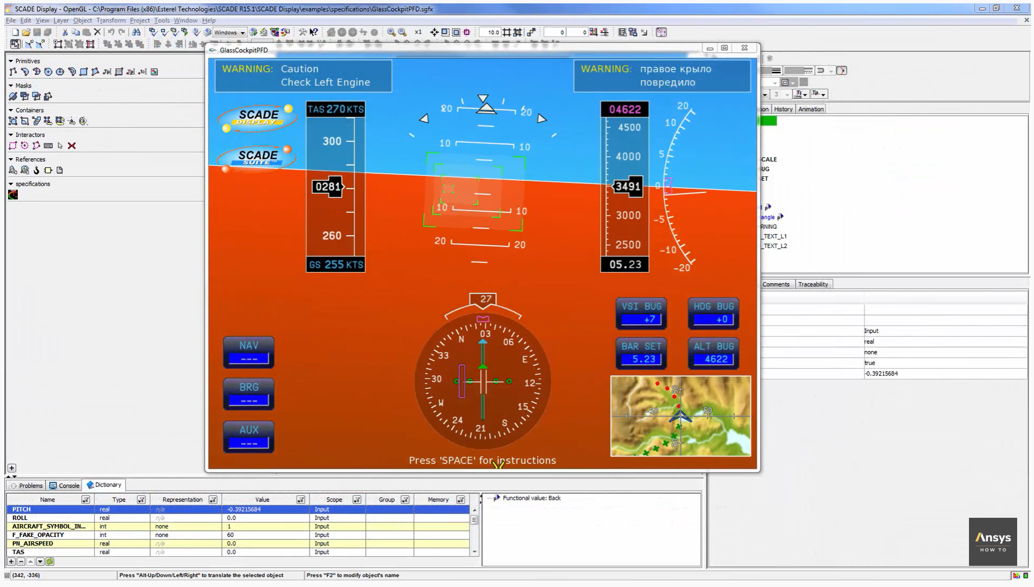



What we don’t address
https://www.youtube.com/watch?v=kaJfTS2WvEA
Notes:
-Another example of Model Animator, from the community of Modelling & Simulation that based on a dedicated modeling language such as modelica langauge, SCADA. System -This figure illustrates a Model animator as dashboard that captures using sensors in real time the atmospheric properties like temperature , and wind speed
-However, In our research we don't address this kind of simulation and animation challenges, because its complexity and the requirement related to strict time constraints. ------------------
-This figure illustrates a Model animator that is a dashboard embedded in the windshield car vehicle.
-During driving the atmospheric properties like temperature, humidity and wind speed are captured in real time using sensors
-In our research we don't address this kind of simulation and animation challenges, because and because its complexity and the strict time constraints.
------
FRP provides an interface to write reactive programs such as graphic animations using (1) continuous time-varying values called Behaviours and (2) discrete values called Events.

Slide 9
What is a Model Animation ?
Visualization (aka. Rendering)
A rendering transformation assigns one (or more) concrete representation(s) to each abstract syntax element or group of elements in an input model, as long as the meta-model of the concrete syntax is defined explicitly.
Simulation
A simulation transformation defines the operational semantics of a modeling language that updates the modeled system’s states.
Inplace & Endogenous
Animation
Animation is the visualization of a simulation
p1:Pacman
in
C1: CELL
id = 1
MoveRight
right
right
CS
Rendering
MM
Parsing
Simulation
?
M_{CS}
M
Animation
Simulation
Lúcio, Levi and Amrani, Moussa and Dingel, Juergen and Lambers, Leen and Salay, Rick and Selim, Gehan M. and Syriani, Eugene and Wimmer, Manuel. (2014). Model Transformation Intents and Their Properties. SoSyM 15(3), 647--684
Notes:
So what is a Model Animation:
By exploring the literature, we realized the presence of confusion in literature between the concepts of visualization, simulation and animation:
To clarify,
first, the visualization: is a rendering transformation assigns one (or more) concrete representation(s) to each abstract syntax element or group of elements in an input model
For example: mapping the pacman icon to the Object class pacman
The simulation: A simulation transformation defines the operational semantics of a modeling language that updates the modeled system’s states, that inplace and Endogenous
for exemple the rules movepacman , update the state model by chainging the pacman position
The Animation: is the visualization of a simulation, so we need to perseive the execution steps and the model state of simulation execution and provides its corresponding animation using a given CS

Slide 10

Proposal: Decouple Transfos From Animation
Transformation
Animation
AU₂
AU₂
AU₂
TU₁
AU₂
AU₄
AU₄
AU₄
TU₂
AU₂
AU₂
AU₆
AU₄
…
…
TU_{n}
AU_{m}
Notes:
- In order to ensure this coordination between animation and transformation, we decide to decouple TUs and AUs.
- MT is decomposed into smaller TU and the animations that are accessed by the TU are represented in the respective unit.
So, how we can benefit from this decoupling
----
We have the possibility to create unites animations
So, how we can benefit from these decoupling
----
We have see that the transformation is decomposed on transformation unit
We following the same appro ach ,,
Our objective is to decompose the animation on small animation unit and link each transformation with ts corresposing units animations
Also,
So, if we
Is because
I there is a … then
However

Slide 11
Providing Flexibility for MA
TU
AU
0..*
Move Token to next State
1.1 Disappear from current, THEN
1.2 Appear into next
AU₁
AU₁
fire()
AU₂
2. HSLIDE Token to next State
1.1 Highlight fired Transition THEN
1.2 Slide Token along Transition into next State
●● ●
AU_{n}
AU₂
Notes:
To making the animation design more flexible , we have propose to use the mapping concept in different way:
First
On TU can be used multiple Animation unit
So this mapping concept between animation and transformation will be used different scenarios one to one, one to many or many to many , in order to to achieve more flexibility in MA animation and Enable the reuse of AUs
- In the first scenario of mapping, we attach one AU to one AU . This means that that a single UT to be visualized in multiple MA ( flexibility concept)
-Second, we attach many more granular sets of AUs with one TU.
For example
to consider alternatives and options and cover all stakeholder view points and views
Monolotique
Based on single animation
Its the way

Slide 12

Enabling Reuse across DSLs
Dsl1
TU_{FSM}
TU
AU
0..*
AU_{i}
Dsl2
TU_{PM}
TU_{FSM} fire ()
TU_{PacMan} moveRight ()
Notes:
In the other hand , this mapping enabling the reuse across DSLs
Son , we can reuse AU for several TU of different DSL.
For example the both unit transformations fire and moveRight can be use the same animation unit just by remplace the token by the persona pacman and the place by the the location CELL

Slide 13
3 Key Challenges
Explicitly define CS for easily expressing MA;
Build an MA language to express AU in a compositional way,
Explicitly relate MA units with their transformation counterparts
Notes:
- Following our vision to provide a Reusable and flexible components for designing MA Tools (Enable the reuse of AUs For different DSL)
- - Following our vision to provide a Reusable and flexible components for designing MA , We have identified three Key Challenges :
Explicitly define CS for easily expressing MA;
Build an MA language to express AU in a compositional way,
Explicitly relate MA units with their transformation counterparts
-----------------
- Three Key Challenges must be discussed:
Explicitly define CS for easily expressing MA;
Build an MA language to express AU in a compositional way,
Explicitly relate MA units with their transformation counterparts

Slide 14
Defining Explicit Concret Syntax
Notes:
First challenge: Concrete Syntax

Slide 15
Complex Rendering Patterns
Rendering
Visual Representation
Final
State
State
...
Initial
Initial
Regular
Regular State
Final
Initial State
Regular
Final State
Transition
Transition
Notes:
To Explicitly define CS for expressing MA; we need a Complex Rendering Patterns
To explain the challenges related to a complex rendering patterns,
let’s consider the following example that illustrate the CS of Finite -state machine , here we have the visual representation of FSM metamodel (Kind state : symbol for Regular, INITIAL and FINAL states and transition)
We can consider three Usages
- The metamodel element can be mapped by visual element of concrete syntax
- For instance the state of FSM metamodel can be represent by a class State that is a generalization of three class initial, final and regular
- So, to visualize this model, we associate for each class the corresponding visual element of the CS

Slide 16
Complex Rendering Patterns
Visual Representation
Final
State
State
...
Initial
Rendering
Regular
Regular State
self.kind == INITIAL
FSM
1 fsm
Initial State
...
1..*
states
« enumeration »
Kind
State
Final State
self.kind == FINAL
INITIAL
REGULAR
FINAL
kind: Kind
Transition
Transition
self.kind == REGULAR
Notes:
In the second scenario, the representation of the rendering function is based on enumerate of these three kind of states,
in this case to visualize the CS , we must write the queries explicitly using query languages (like OCL-style constraint.) to define the rendering function

Slide 17
Complex Rendering Patterns
Visual Representation
Final
State
State
...
Initial
Regular
Regular State
We do not control how the metamodel is designed
The rendering process can become arbitrarily complex
Need a DSL for capturing the CS + Rendering
FSM
1 fsm
Initial State
...
1..*
states
Rendering
« enumeration »
Kind
State
Final State
INITIAL
REGULAR
FINAL
kind: Kind
Transition
self == self.fsm.initial
Transition
FSM
1 fsm
...
self == self.fsm.final
1..*
states
State
1 initial
...
1 final
not (... or ...)
Notes:
In the third scenario, the INITIAL, FINAL and REGULAR states are defined based on references.
So the rendering function is defined as set of OCL expression based on references evaluation
So, From this example, one can see from a simple DSL , a multiple rendering scenarios that must be considered
In fact, we need a complex rendering patterns to handle these scenarios,

Slide 18
Integrating “insideness” natively
C
Class
Attribute
a: attribute
+
Abstract
Persona
in
Cell
+
Notes:
-Other feature must be considered in rendering function is to Integrating “insideness” natively
-- To more understand the problem, consider the composition notion between the class and its attributes
-in the concrete syntax usually we associate a graphical element to each class of abstract syntax
-So nesting and placing one graphic element on top of another, called insideness
-For example in pacman DSL the relationship in -> means to place the personna in the cell center
-So this notion does not exist natively, however, defining insidness from scratch its complex task and error prone, so we need to define a dedicated solution to fully unlock the potential of MA engineering,
----
Au MM, j’ai la notion de composition, graphique a donne ca
Un truc dédié -> natively
-cette notion n’est pas nativement existe (that does not exist natively )
Laisser ca pour l’utilisateur c’est difficile (howver, defining from scratch irs complex task and error prone, so we define a dedicated solution unlock fully th MA designer)
Associer un élément graphique a chaque classe
Truc au milieu -> position
___
Placer sue l’autre
Impriquer
Voici la re presenttaion grapuque qui coresspond
- To more understand the problem, consider the scenario of Pacman game when persona Pacman eats ghost
- As we can see, this illusion can be specifies by sequence of animation in sequential and parallel mode
So a complex visual effect, can obtained by Sequences of images chained to provide this illusion
----
J’ai la notion de composition
----------------------------
Au MM, j’ai la notion de composition, graphique a donne ca
Un truc dédié -> natively
-cette notion n’est pas nativement existe (that does not exist natively )
Laisser ca pour l’utilisateur c’est difficile (howver, defining from scratch irs complex task and error prone, so we define a dedicated solution unlock fully th MA designer)
Associer un élément graphique a chaque classe
Truc au milieu -> position
___
Placer sue l’autre
Impriquer
Voici la re presenttaion grapuque qui coresspond

Slide 19

Supporting animations natively
Fast Update of Visual Features
Browsing, customize/extend/modify
e.g., the position, size, color
Conjoined/Nested Element Block
Usability Mechanisms
Using the Graphical Elements
Using Visual Language
e.g. Block Oriented Modeling, Causal Modeling
Visual Editor Workspace
Visual Features
- Position
- size
- color, ..
Graphical Elements
MA Designer
Edit Element
Notes:
- In the Complex Rendering Patterns, we must support animations natively, regarding the high demands of UX design usability,
- This feature means the capabilities to assist designers create a successful animation product by browsing the existing graphical element, enriching, editing and customizing them.
So, we believe that providing a visual language, allows designers to take advantage of flexibility and reusability of its library component.
- A Visual language allows editing of the properties of the selected elements in the canvas and adopting a drug-and-drop style for the animation building
- This make it more an animation design flexible and fully unlock the CM engineering potential.

Slide 20
Define a Model Animation Language
Notes:
Now, we move to the second challenge : MA Specification

Slide 21

Designing compositional AU
M₀
Initial Model
How to separate effects from scheduling
TU₁
AU₁
M₁
Define MA Effects
TU₂
AU₂
dependency
AU₃
M₂
AU₄
Define composition of AUs?
TU₃
AU₅
AU₆
M₃
How to coordinate TU<>AU ?
AU₇
●● ●
AU₈
●● ●
●● ●
[1] Syriani, Eugene and Vangheluwe, Hans (2010). De-/Re-constructing Model Transformation Languages. In Workshop on Graph Transformation and Visual Modeling Techniques.
DOI: http://dx.doi.org/10.14279/tuj.eceasst.29.407
Notes:
The coordination between Animations and transformation chain, is driven by trigger events, in witch, one step of transformation triggers one or several animation steps,
For instance, we can see from Figure:
The first transformation step corresponds to one AU step
The second and fourth transformation step correspond to 3 steps
And the third correspond to 5 animations steps
So, to design the animation in this a compositional way, we need to answer three main issues
--------------
The question here, how to orchestrate this execution between the both process ?
----
Trafo is a program to perform coordinate transformations useful in combination with the analysis of single-crystal NMR spectra
--------------------------
Initial model -> truc graphique
Rien ne garantir comment exécuter AU
Comment relier
Comment définir AU

Slide 22
MA Effects
Appearing
● ● ●
APP
ZOOMIN
Disappearing
● ● ●
DAPP
ZOOMOUT
Action
● ● ●
Change Color
Change Style
Notes:
- For MA effect, We have identify atomic and derived AU
- For Atomic MA Effect, we have
- Appearing Effect: like zoomin
- Disappearing Effect: like zoomout
- Action Effect: like change color and style
Other animation like path follow can be derived from combining these primitives

Slide 23
Linking Effects with Elements
DAPP
DAPP
what
from
what
from
1
t1: Token
s1: State
name = 1
rendering
Notes:
On suppose un block qui capture l’animation fire that is inside the ransformation accept
This block has customized parameters
So, there is two way: fist one using the objects of the model
The second is to use the elements of the concret syntax
The bowth block are equivalent if we have the renderinf fucntion, so designers can use the appropriate block according to their requirements.
__________________
Et on a des paramètres
On a deux choix : use -> model (objets de modèles )
use -> élément graphique de la syntaxe concetet (tockens et place)
C’est équivalent si on a le rendering
Conclusion: souvent on donne l’acces au deux à designer pour utiliser le plus pratique pour lui
----
An animation is made up of components or building blocks
to consider alternatives and options and cover all stakeholder view points and views
----
- AU can be parametrized to support the reuse aspect.
- Here an example of move Right of Pacman, so the similar AU be duplicated by for all moves, just by parameterize the persona and the direction
- Also the optional parameter of appear or disappear frequency can be used in order to show that the persona follows a specific path between CELLS
- This AU of move right can be reused for other DSL, like fire token, in which Pacman is replaced by token and CELL is replaced by place
So, we must define a generic Animation Unit APP-DAPP that
Make a specific element
Disappear from a location, and
Appear into another location

Slide 24
Defining several animations for fire()
A Transition is fired, changing the current State
TU fire, defined inside the general transformation accept
:DAPP
MOVE
:APP
:HIGHLIGHT
HSLIDE
:SLIDE
Notes:
The bloxk of animation can be composed to animate the TU fire defined inside the transformation accept
To desining this naimation, we use the block depeat and appear to depeapar the tochens from the current location and appear its in the target place
The second block aof animation animation is start by haliting the tockens in the current plac flowing by sliding its into the targer place
Considere the transformation fire
We can define severall animations for this transformation unit
An animation can be create by composting the primitive components
The first animation is the composition of deapear tockand and appear tocken on the second place
The second animaion is hilght the tolens flowed by the sliding to the target place
----
On a des blocs
On peut créer des animations d’une manière compositionnelle
Une fois qu’on a la composition -> on peur créer a complexe animation
-------------------------
- AU can be parametrized to support the reuse aspect.
- Here an example of move Right of Pacman, so the similar AU be duplicated by for all moves, just by parameterize the persona and the direction
- Also the optional parameter of appear or disappear frequency can be used in order to show that the persona follows a specific path between CELLS
- This AU of move right can be reused for other DSL, like fire token, in which Pacman is replaced by token and CELL is replaced by place
So, we must define a generic Animation Unit APP-DAPP that
Make a specific element
Disappear from a location, and
Appear into another location

Slide 25
UA Scheduling
Embedding the scheduling inside the UAs
Define combinators outside of UAs
PRE
HSLIDE
AU1
HIGHLIGHT
SLIDE
;
POST
PRE
HSLIDE
HSLIDE
…
HSLIDE
;
;
AU2
POST
abc
a
a
●● ●
b
b
c
c
a
b
a
b
a
Notes:
Now For AU Scheduling, we have two main Theoretical Approaches
- The first the Scheduling is Embedding the scheduling inside the UAs, this means that defined inside each unit animation using pre-condition and post-condition of each unit animation
- The second method is to define combinators of sequential and parallel mode outside of Uas
La logique de l’animation: separer les elemnts graphique sue le quel elle s’applique
Les^paramètres qui gere la logique pour l’appliquer
-------
Now we try to construct this animation ( nous allons essayer de construire cette animation)
Desapear/ appear, deplacer et clignoter

Slide 26
A DSL for the definition of the effets
A DSL for Mapping Elements to the effets
A DSL for the definition of UA Scheduling
Notes:
Need a DSL for les effets
A DSL for Mapping Element with les effets avec les deux possibilité
DSL pour UA sceduing ave les deux possibilités

Slide 27
Relate AUs with TUs
Notes:
The third challenge is how relating AU and TU

Slide 28
MT < > MA Coordination
Tag TUs that are amenable to MA
Add annotations on TUs (e.g. @Step)
Define a Communication Protocol
What is happening in the Transformation Engine
Which information should be transmitted
M₀
TU₁
M₁
AU₂
@Step
TU₂
AU₄
M₂
AU₂
@Step
AU₆
breakpoint
stepInto
stepOver
TU₃
AU₄
stepOut
play
examine
steps
M₃
examine model state
[5] Erwan Bousse, Dorian Leroy, Benoit Combemale, Manuel Wimmer, and Benoit Baudry. Omniscient Debugging for Executable DSLs. Journal of Systems and Software, 137:261–288, 2018
Notes:
Now we need to be able to notify the MA engine that a TU is currently executed, so the MA engine performs the animation.
Two problems here:
1.How do we locate relevant TUs inside the overall transformation?
2.What is the communication process between both engines?
To solve the problem, we have proposed to use the GeMoC approach for debugging:
- Annotations for TU: This is used in a declarative way by the metaprogramming paradigme (e.g., the @Step annotation provided by Kermeta).
- Communication protocol based on Interactive Exploration Services provided by the most debugger of MT engine . This services helps to get the the execution step and the state model before and after execution of unit transformation

Slide 29
What about reusing MA
D_APP
D_APP
DAPP
;
APP
period=_default
DAPP
;
APP
what
from
what
on
what
from
period=_default
what
on
what
from
to
from
to
what
:Token
f:State
t:State
:Token
:Pacman
f:Cell
t:Cell
f:State
t:State
right
left
Notes:
- AU can be parametrized to support the reuse aspect.
- Here an example of move Right of Pacman, so the similar AU be duplicated by for all moves, just by parameterize the persona and the direction
- Also the optional parameter of appear or disappear frequency can be used in order to show that the persona follows a specific path between CELLS
- This AU of move right can be reused for other DSL, like fire token, in which Pacman is replaced by token and CELL is replaced by place
So, we must define a generic Animation Unit APP-DAPP that
Make a specific element
Disappear from a location, and
Appear into another location

Slide 30
Conclusion
TU
0..*
0..*
AU
Key Challenges
Concrete
Syntax
Complex Rendering Patterns
Integrating “insideness” natively
Supporting animations natively
…
Lack of ﬂexibility in MA
Enable the reuse of AUs
MA
Specification
UA
Composer
UA
DSL Tools to perform MA alongside of MT
MA Designer
MT < > MA
Coordination
class PacMan { ... @Step def boolean moveR() {
MT
MA
@Step
Notes:
At the-end;
-To summarize, I have presented a the Systematic Design of Model Animation as key Ingredients and General Guidelines
-i have noticed that MA designer need a DSL Tools to perform MA alongside of MT
-This because a Lack of ﬂexibility in MA and to enable the reuse of AUs
-Our vision is to the use the concepts of mapping between AU and TU
-Three Challenges have been identified behind this vision
-First, for the concrete syntax the challenge is how to provide a complex rendering patterns to handle the variability specification in AS
-Secondly, MA specification by decoupling : Model Animation Effects, from Model Animation Scheduling
-Finally, the coordination between the both engine is based on annotation and communication
As future work, we are now in the phase of implementing our framework and validation through a case study
—----------------
Tank you for your attentions

